Slide 1

6th Grade Math
Unit 11, Lesson 5 Generating Equivalent Algebraic Expressions Volume 1, pg. 261

Slide 2


Benchmark
MA.6.AR.1.4
Apply the properties of operations to generate equivalent algebraic expressions with integer coefficients.
volume 1, pg. 261

Slide 3
Integrated Mathematical Thinking and Reasoning Standards
MA.K12.MTR.1.1 Actively participate in effortful learning both individually and collectively.
MA.K12.MTR.4.1 Engage in discussions that reflect on the mathematical thinking of self and others.
MA.K12.MTR.5.1 Use patterns and structure to help understand and connect mathematical concepts.
volume 1, pg. 261

Slide 4

Learning Target
I can apply properties of operations to generate equivalent expressions.
volume 1, pg. 261

Slide 5

Warm-Up
volume 1, pg. 262

Slide 6
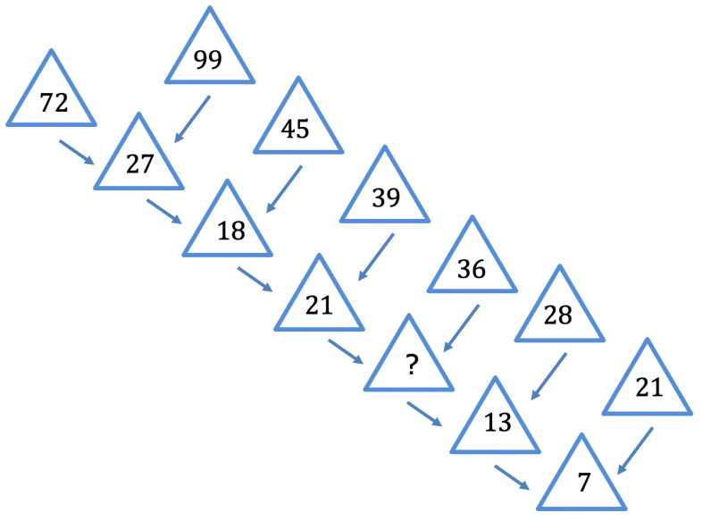
11.5.1 Warm-Up: Missing Number
What is the first number you tried for the missing number?
Did your first number work for the rest of the pattern?
What strategy did you try if your first number did not work?
volume 1, pg. 262

Slide 7

Guided Instruction
volume 1, pg. 262

Slide 8
11.5.2 Guided Instruction: Generating Equivalent Algebraic Expressions
Consider the following expressions.
Which of these expressions are equivalent?
Which property of operation justifies that the expressions are equivalent?
Write two equivalent expressions. Name the property or properties you used to create each equivalent expression.
$$8∙x+8∙9$$ | $$8(x+9)$$ | $$8x+9$$
volume 1, pg. 262

Slide 9
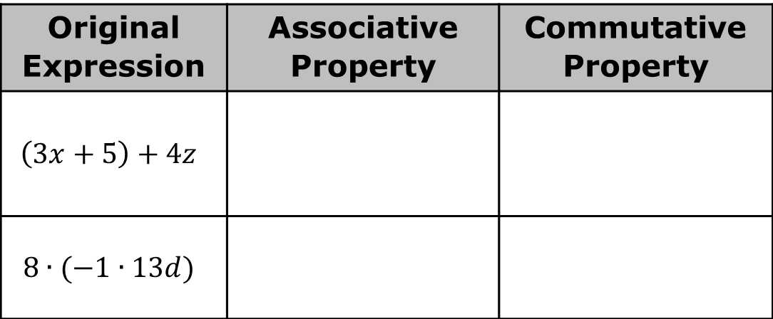

For each expression, use the associative and commutative properties to generate an equivalent expression.
Rewrite $−11b+3(10k+1)$ using the distributive property.
Rewrite $−11b+3(10k+1)$ using the commutative property of multiplication.
Rewrite $−11b+3(10k+1)$ using the commutative property of addition.
Original Expression | Associative Property | Commutative Property
$$\left(3x+5\right)+4z$$
$$8∙(−1∙13d)$$
volume 1, pg. 262-263

Slide 10
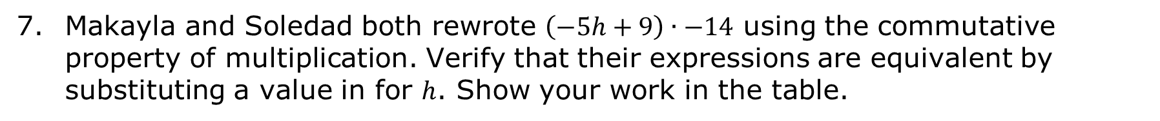
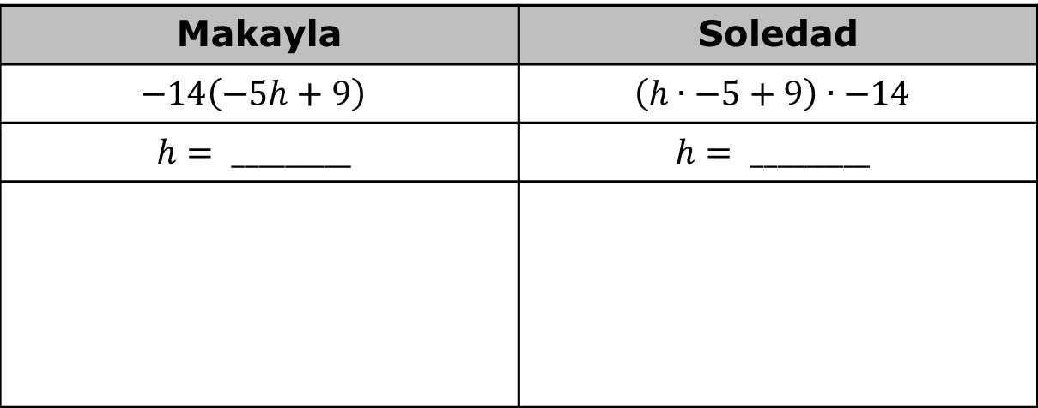
Makayla and Soledad both rewrote $\left(−5h+9\right)∙−14$ using the commutative property of multiplication. Verify that their expressions are equivalent by substituting a value in for $h$. Show your work in the table.
Makayla | Soledad
$$−14\left(−5h+9\right)$$ | $$\left(h∙−5+9\right)∙−14$$
$$h= _________$$ | $$h= _________$$
volume 1, pg. 263

Slide 11
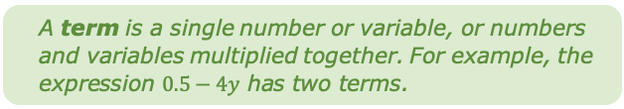

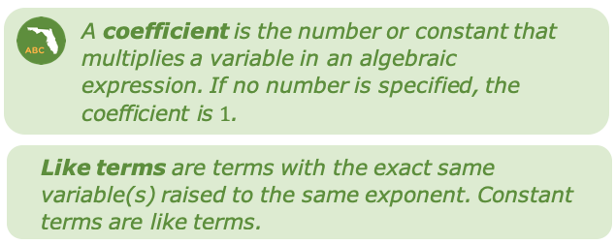
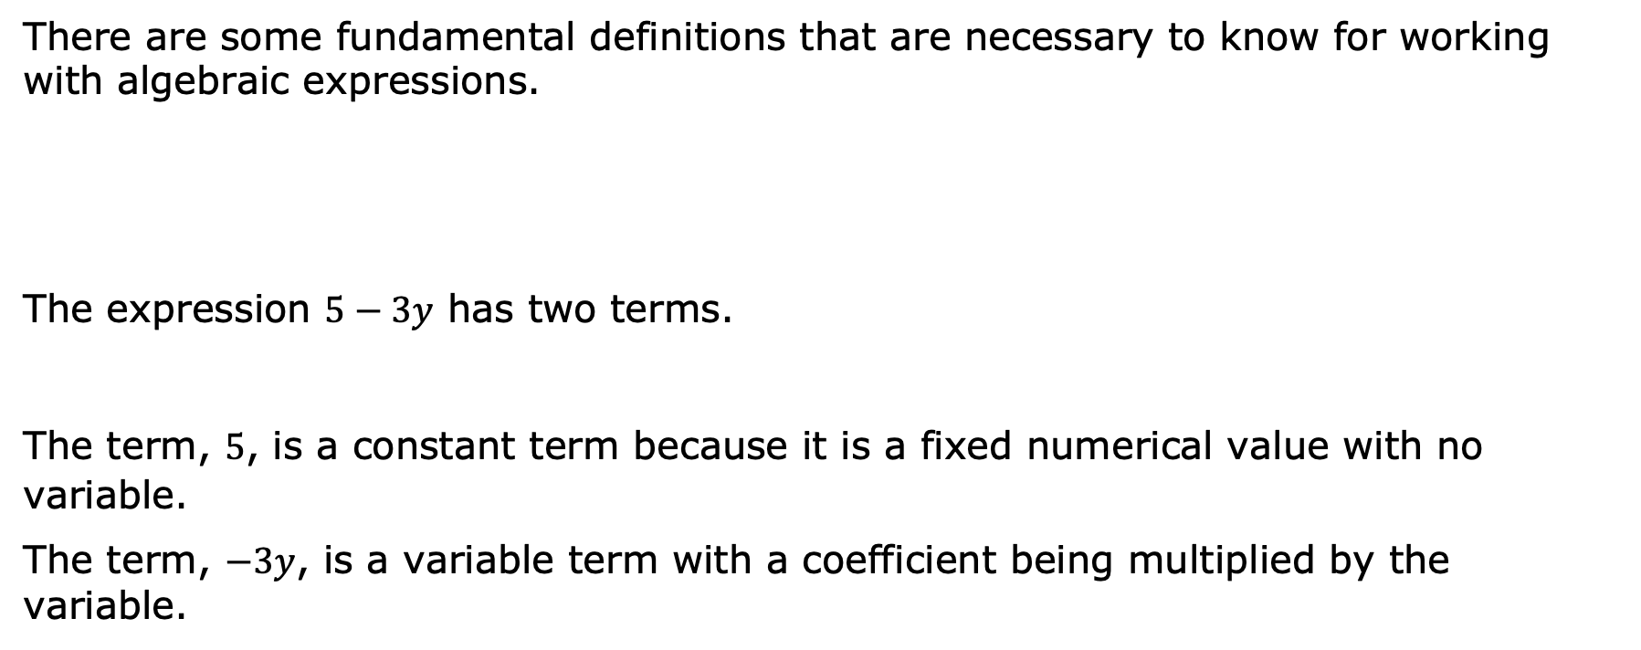
There are some fundamental definitions that are necessary to know for working with algebraic expressions.
The expression $5−3y$ has two terms.
The term, $5$, is a constant term because it is a fixed numerical value with no variable.
The term, $−3y$, is a variable term with a coefficient being multiplied by the variable.
volume 1, pg. 263

Slide 12
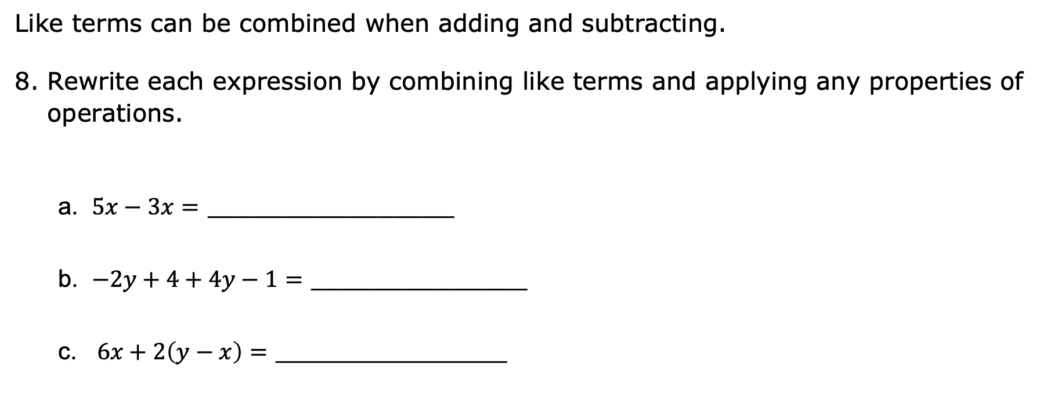
Like terms can be combined when adding and subtracting.
Rewrite each expression by combining like terms and applying any properties of operations.
a. $5x−3x=$ ________________
b. $−2y+4+4y−1=$ ______________
c. $6x+2\left(y−x\right)=$ _______________
volume 1, pg. 263

Slide 13

Try It
volume 1, pg. 264

Slide 14

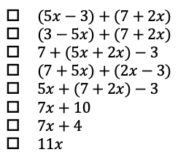
11.5.3 Try It: Writing Equivalent Algebraic Expressions
Select the expressions that are equivalent to $(2x+7)+(5x−3)$.
volume 1, pg. 264

Slide 15
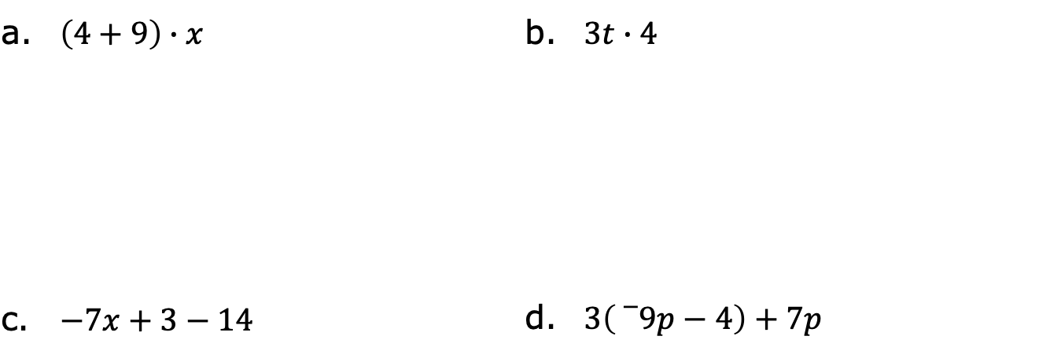
11.5.3 Try It: Writing Equivalent Algebraic Expressions
Write two equivalent algebraic expressions for each expression below.
a. $\left(4+9\right)∙x$ | b. $3t∙4$
c. $−7x+3−14$ | d. $3\left({}_{}^{−}9p−4\right)+7p$
volume 1, pg. 264

Slide 16

Your Turn
volume 1, pg. 264

Slide 17
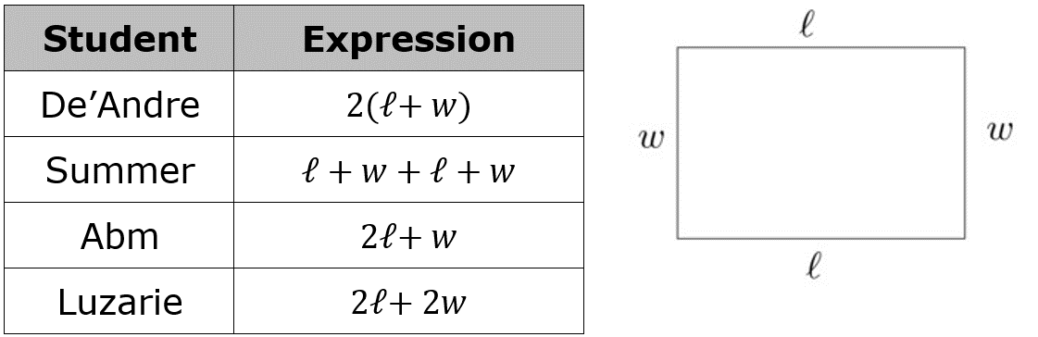
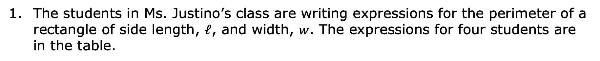
11.5.4 Your Turn!
The students in Ms. Justino’s class are writing expressions for the perimeter of a rectangle of side length, $𝓁$, and width, $w$. The expressions for four students are in the table.
volume 1, pg. 264

Slide 18
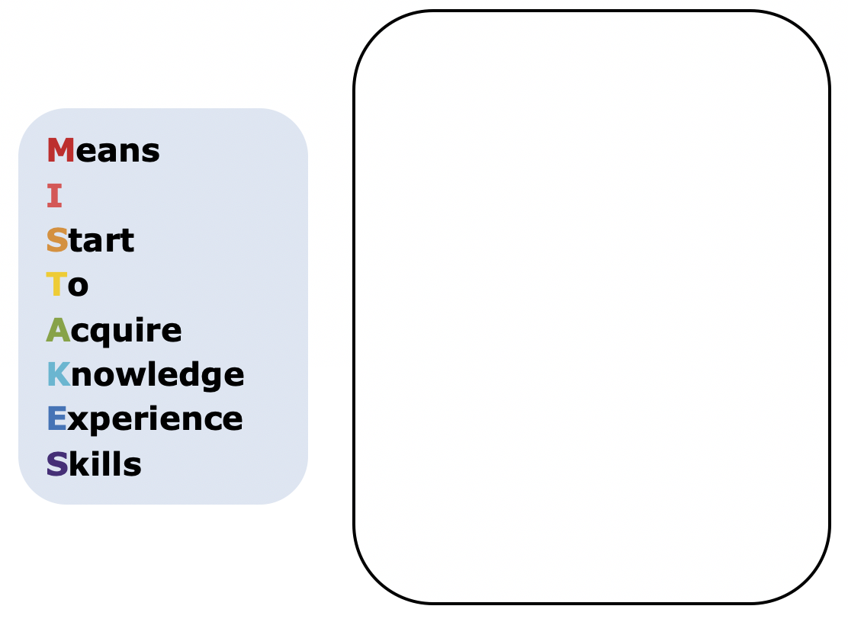
Ms. Justino told the group that one of the expressions is not equivalent. Write a short explanation to the student to show why their expression is not equivalent to the other expressions.
volume 1, pg. 264

Slide 19
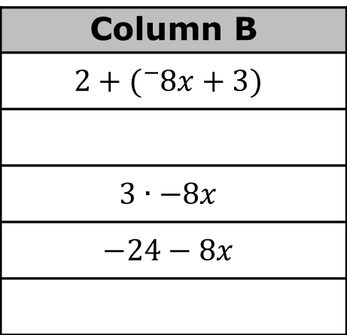
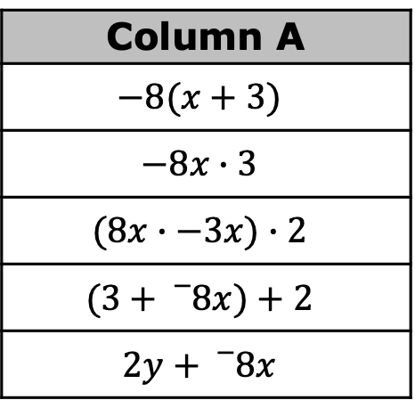
Match equivalent expressions by drawing an arrow. If an expression does not have a match, write an equivalent expression to match it in one of the blank boxes provided.
Column A
$$−8(x+3)$$
$$−8x∙3$$
$$(8x∙−3x)∙2$$
$$(3+{}_{}^{−}8x)+2$$
$$2y+{}_{}^{−}8x$$
Column B
$$2+({}_{}^{−}8x+3)$$
$$3∙−8x$$
$$−24−8x$$
volume 1, pg. 265

Slide 20

Wrap-Up
volume 1, pg. 265

Slide 21
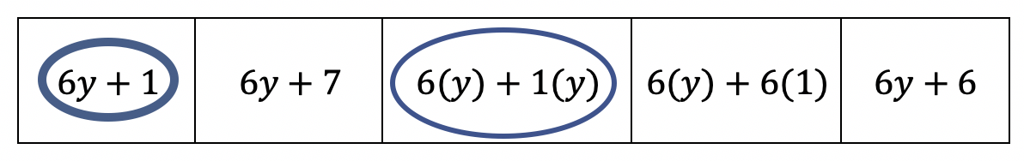
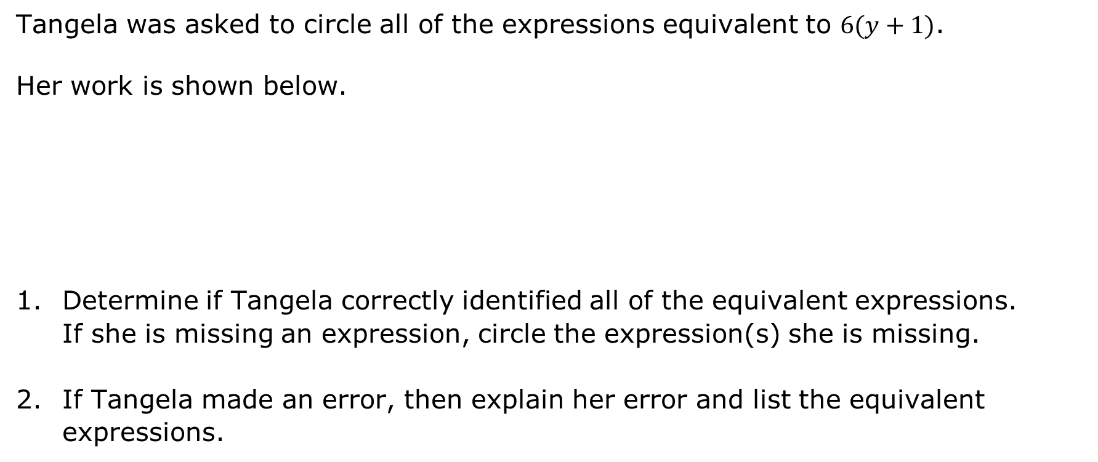
11.5.5 Wrap-Up: Error Analysis
Tangela was asked to circle all of the expressions equivalent to $6(y+1)$.
Her work is shown below.
Determine if Tangela correctly identified all of the equivalent expressions. If she is missing an expression, circle the expression(s) she is missing.
If Tangela made an error, then explain her error and list the equivalent expressions.
volume 1, pg. 265

